Slide 1
Movement Sense
Analyzing Movement using Pose Estimation and Intel 3D Camera
Noy Boutboul
Mark Fesenko
Supervised by:
Yaron Honen
Alon Zvirin
As a part of a research by:
Dr. Maayan Agmon

Slide 2
Abstract
Body posture is one of the fundamental indicators for evaluating health and quality of life. As a part of a research that aims to detect and analyze human posture, our goal in this project is to develop a method to extract accurate body posture measurements using photogrammetry tools.

Slide 3
Goals
Extract data using Intel Realsense 3D cameras
Use AI pose estimation algorithms to predict body posture
Analyze output data and calculate body posture measurements.
Validate results with Vicon’s data )ground truth).

Slide 4
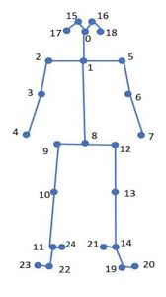

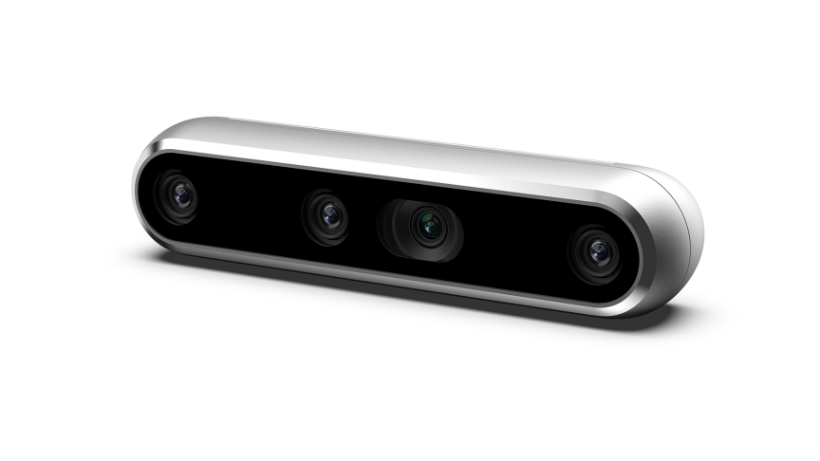
Environment & Tools
PyCharm IDE
Python 3.7
Tkinter
OpenCV
Intel Realsense
Intel Realsense Depth Camera D435 / D415
Intel Realsense Github source.
SDK 2.0 (python wrapper)
Pose Estimation
AlphaPose – Github source
Cubemos – Cubemos SDK
OpenPose – Github source

Slide 5
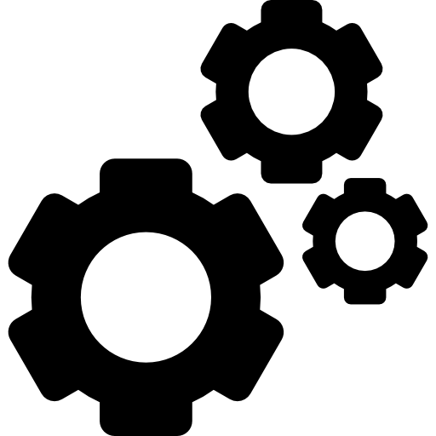


Project Overview
1
Pipeline Creation
Build pipline that includes Realsense data collection, skeleton extraction, precise measurement calculation and display
2
Vicon Validation
Validate our method and results with the Vicon data (regarded as ground truth)
3
GUI tool
Provide an Accessible-to-all tool to automate the analysis and validation process of the data collected by Realsense and Vicon systems.

Slide 6
Pipeline
Building the main pipeline, includes Realsense data collection, skeleton extraction, measurement calculation and result display

Slide 7
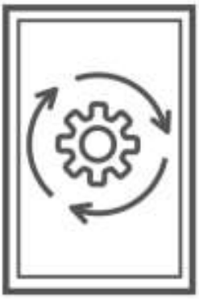

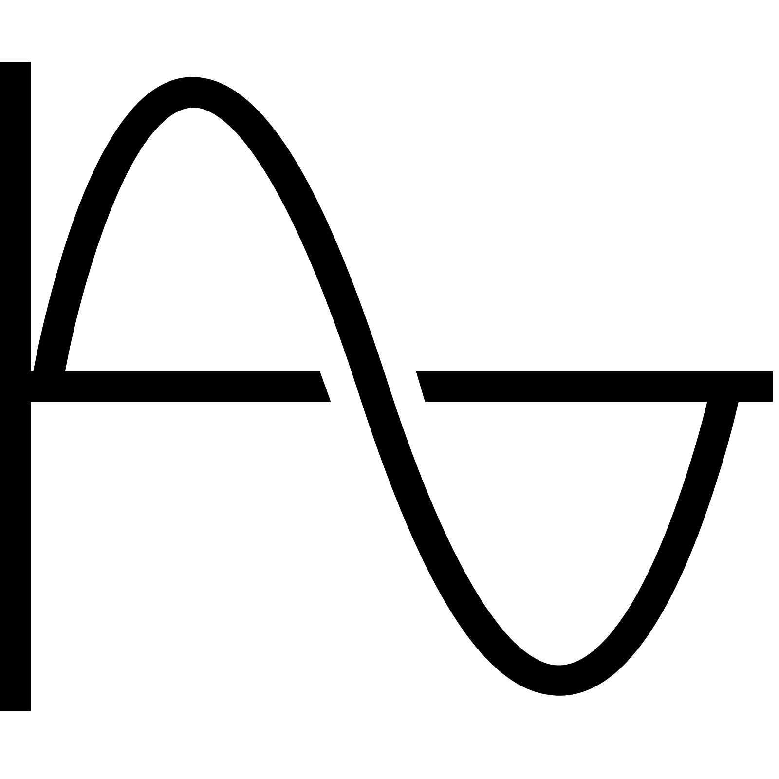

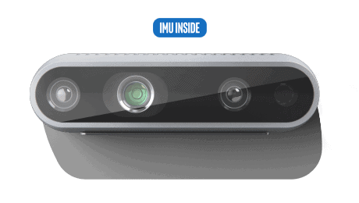
Pipeline Diagram
Realsense 3D Camera
Video Processing
Pose Estimation
Calculations
Results Display
Collecting samples from Realsense Cameras
Processing RGB & Depth frames
Predicting Skeleton key points
Calculating posture measurements
Displaying Graphs Visualization

Slide 8
Pipeline - Zooming In…
RGB & Depth Frames Alignment
Aligning RGB and depth frames by their closest timestamp, working with alignment by depth as it improves the accuracy of the results
Pose Estimation Algorithms
Used 3 different pose estimation algorithms; AlphaPose, OpenPose and Cubemos. OpenPose showed the best results and had the least ‘noise’.
Outer Projection Problem
The projection of a 2D pixel into a 3D space results in a depth point which lays on the outer body. This is problematic when trying to extract certain data such as head tilt angle, body tilt angle.

Slide 9


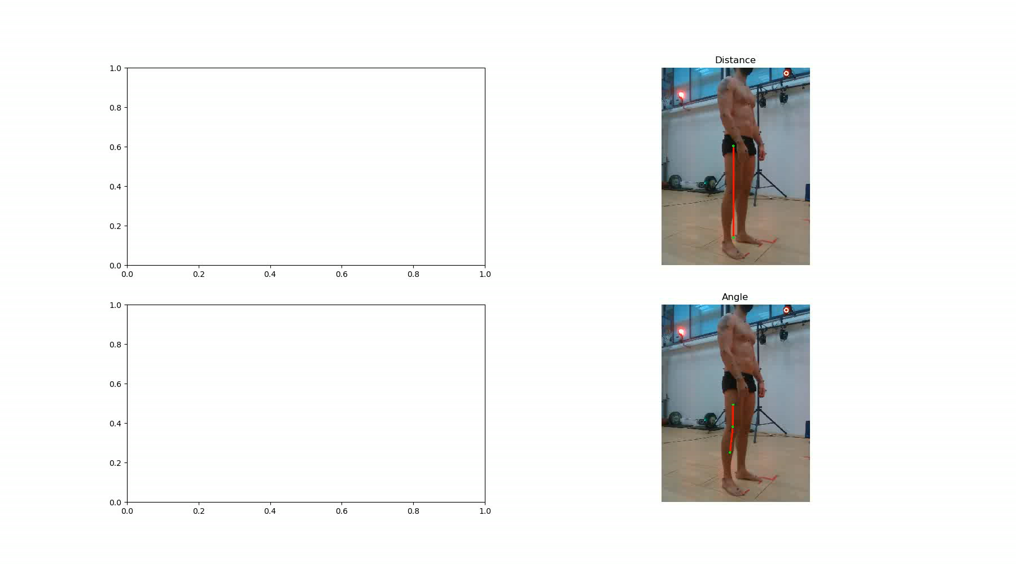
Pipeline - Vizualization
9

Slide 10
Vicon Validation
In order to validate our results kinematic measurements by three-dimensional (3D) motion analysis systems were recorded using VICON along with Realsense recordings.
Currently, the Vicon system is regarded as the “gold standard” for assessing the kinematics of human movement.

Slide 11
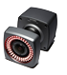

Vicon Validation Diagram
Vicon Cameras
Syncing
Calculations
Syncing timestamps Matching Realsense and Vicon frames
Comparing results Calculating correlations Generating Graphs
Realsense 3D Camera

Slide 12
Vicon Validation - Zooming In…
Vicon doesn’t provide timestamps
Unfortunately, the Vicon doesn’t output timestamps on its frames. We built a sync-by-movement code that detects T pose (standing with hands raised orthogonal to the body). Using this method we aligned the Vicon and Realsense frames.
(videos start with T pose)
Anatomical vs Estimated Skeleton
While the Vicon’s skeleton points are precise anatomically, the skeleton points extracted using OpenPose had little to no relation to anatomical points. This caused a d big difference when calculating measurements such as shoulder’s kyphosis, head tilt, etc..

Slide 13
Exploratory Results

Slide 14
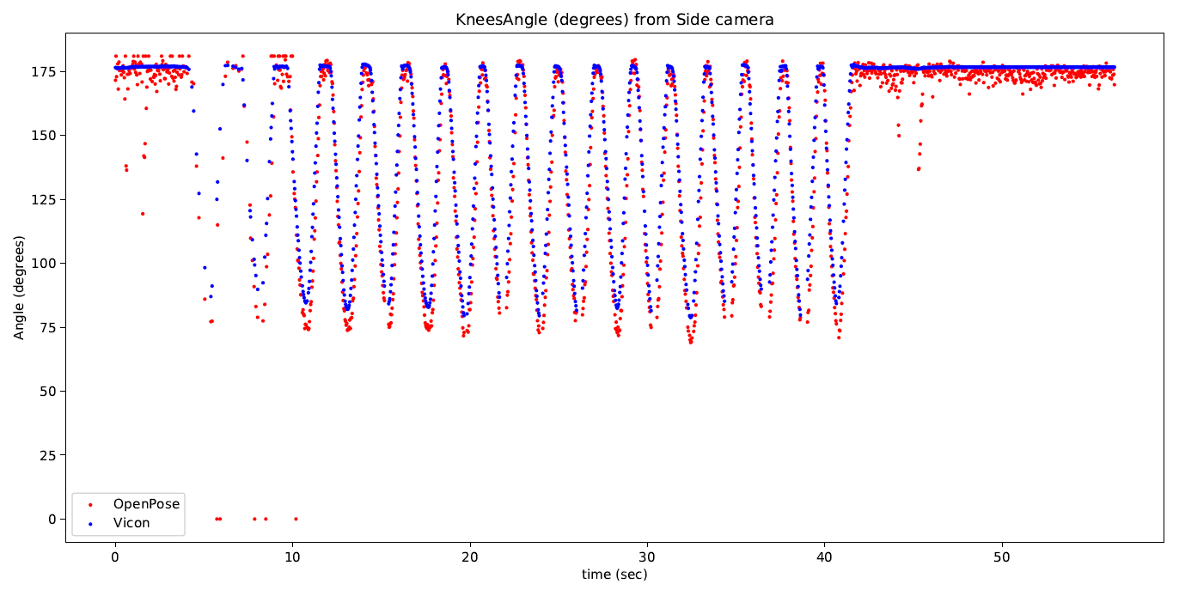
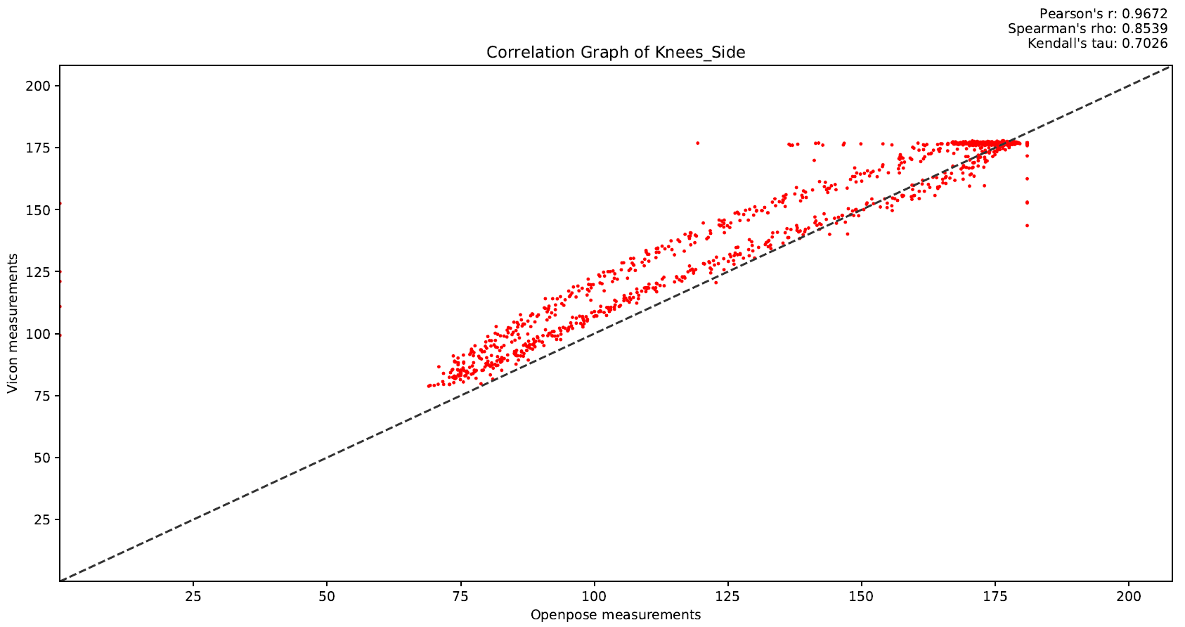
Frames alignment, Knee angle, squatting, Realsense side view
Vicon – Realsense Correlation, Knee angle, squatting, Realsense side view

Slide 15
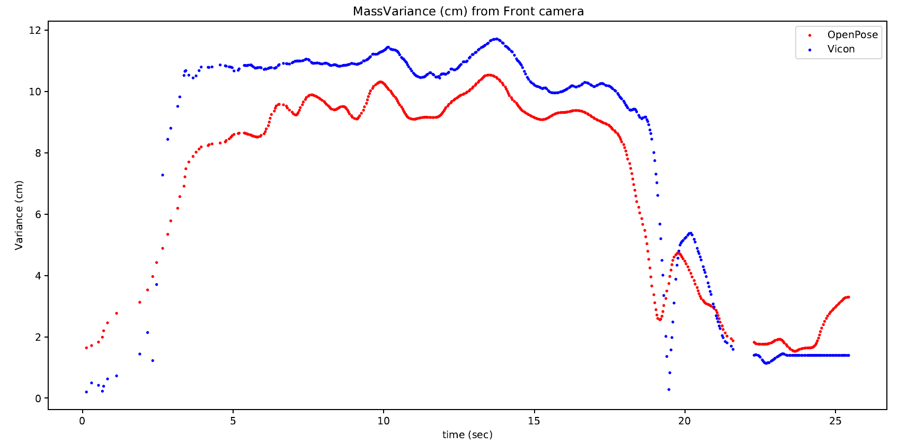
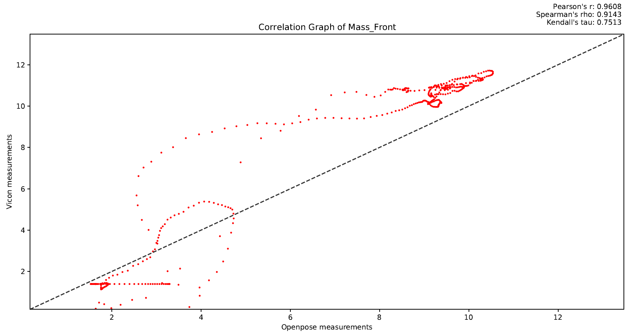
Frames alignment, Center-of-Mass, standing left leg, Realsense front view
Vicon - Realsense Correlation, Center-of-Mass, standing left leg, Realsense front view

Slide 16
GUI Tool
We provide an accessible-to-all tool to automate the measurement extraction pipeline, analysis and validation process of the data collected by Realsense and Vicon systems.

Slide 17
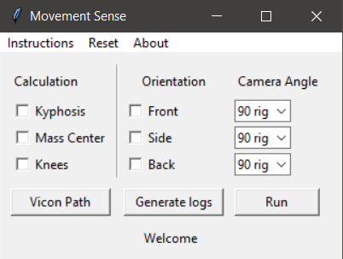
GUI Overview
Choose the orientation of the shooting (Realsense)
Reset cached files
Open instructions window
Calibrate the orientation (based on how the shooting was taken)
Choose which calculation you want to calculate, currently supporting these three
Setting path to directory. Navigate the program to your vicon.csv
Starts the pipeline
Status message, indicates the current status (“welcome”, “working on 1/3 bag file”, “calculating measurements”, ”exporting graphs”, “done”)
Generates logs to align depth to RGB frames

Slide 18
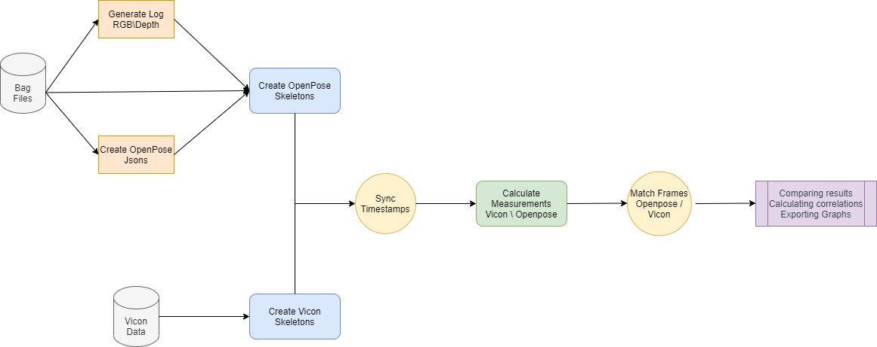
Code Flow Chart
(Separate)

Slide 19
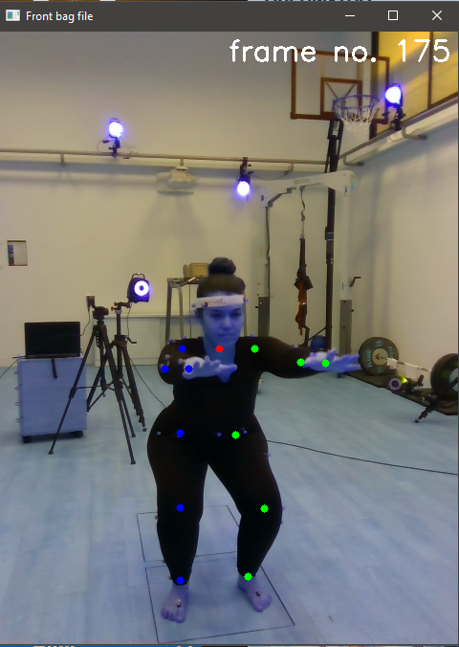
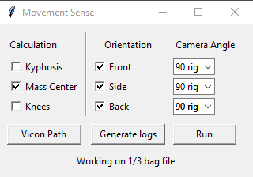
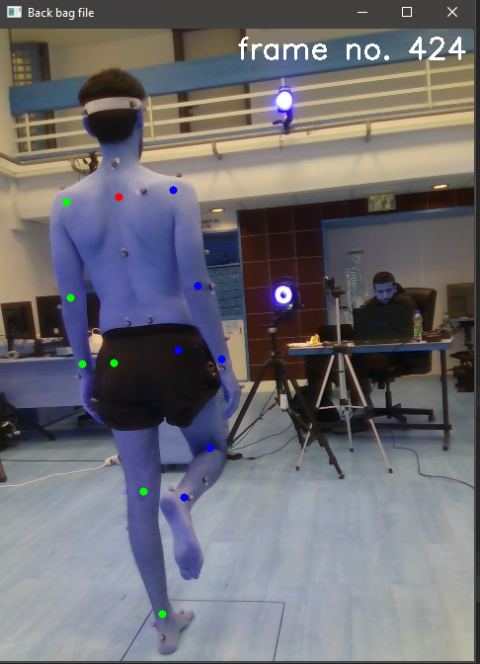
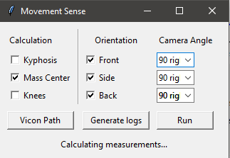
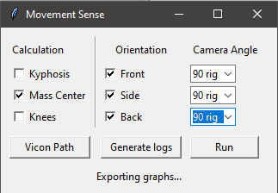
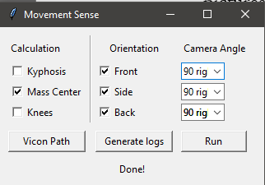
Example run

Slide 20
Conclusions
Our method was strongly correlated with the ground truth in measurement involving anatomical points available in our system.
Some measurements relying on points unavailable in our system could still be estimated, via areal points highly correlated to those.
However, our system still is much less reliable than the Vicon system. Measurements contained more noise and were sometimes biased. This can be addressed in future studies

Slide 21

Future work
Our results shows that extraction of body posture measurements using photogrammetry tools is correlated with the “ground truth” data to an extent. In addition our method yielded results with noise and some a bias. Perhaps, it will be more robust to try training a machine learning model that given the Vicon data as labels could train on the 3D video samples. A well-trained model could be able to predict skeleton points up to their anatomical level and have high precision and reliability with in compare with the Vicon system.

Slide 22
Thanks!
Any questions?

